Slide 1


Alison Firth
Treasurer, Cardiff U3A
Notes:
20

Slide 2

The Organisation
What we do
Joining and expectations
Notes:
20

Slide 3

University of the Third Age
World wide network
Members join each local organisation who have their own committee
Third Age Trust – National umbrella body

Slide 4

What’s in a Name?
Charitable Purpose: ‘Advancing Education’
Opportunity to study and learn
Sharing of knowledge and peer learning
This Photo by Unknown Author is licensed under CC BY
Notes:
<number>

Slide 5

The Third Age
What’s that and why doesn’t it involve age?!!!
Notes:
<number>

Slide 6

Why seek us out?
Fed up of lunching out!
Too much ‘chat’ – want to DO something?
Don’t want any exams
Do want to pursue an interest and learn
Can’t attend a weekly taught course
Happy to research a topic yourself
Want to be with people not just a book or computer!
Want to share what you learn

Slide 7

What’s on Offer
Variety of Interest Groups
Each with a Convenor
Member joins Group
Can join as many Groups as you want

Slide 8
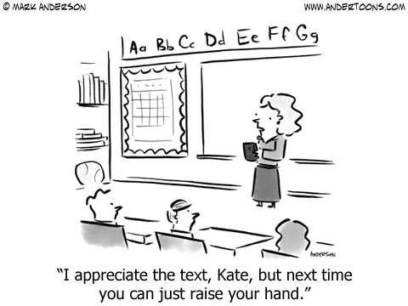
What’s on Offer
Variety of Styles
  Talks
  Shared presentations
  Discussion
  Trips and fieldwork
  Activity led

Slide 9



Groups

Slide 10



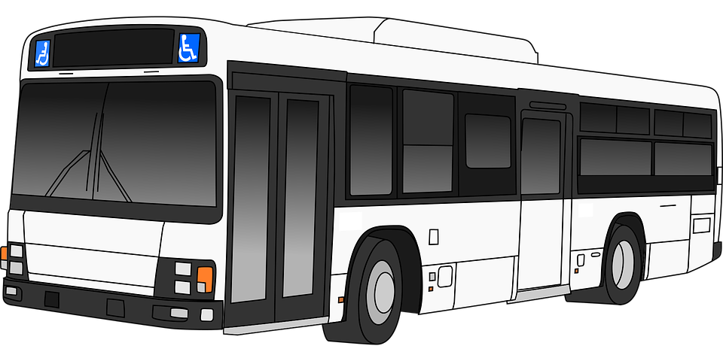
Groups

Slide 11

Frequency of Meetings
Monthly meeting open to all members
Group meetings…….weekly to monthly
  1 hour to 2.5 hours
Many groups break for August

Slide 12
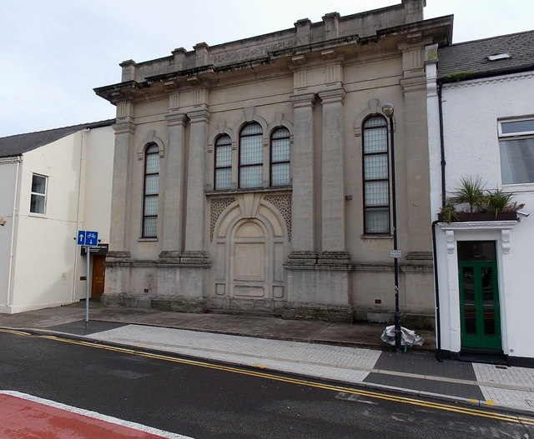
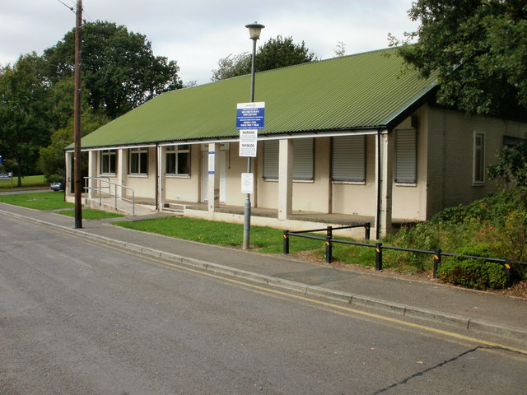
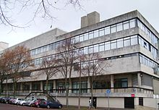
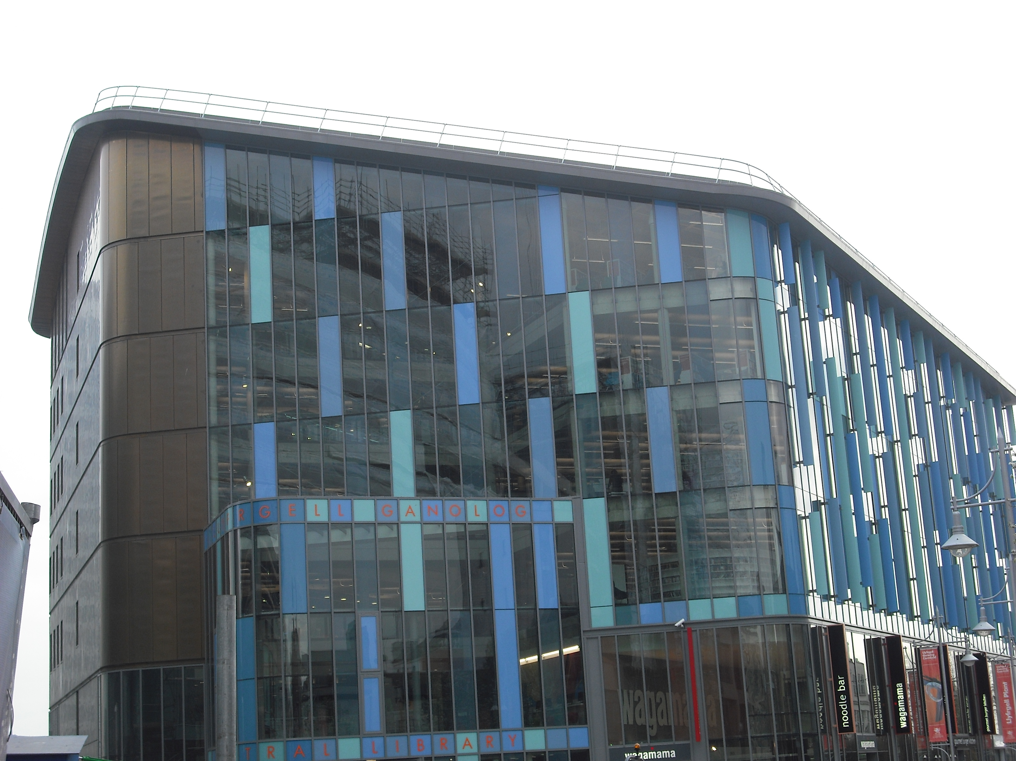
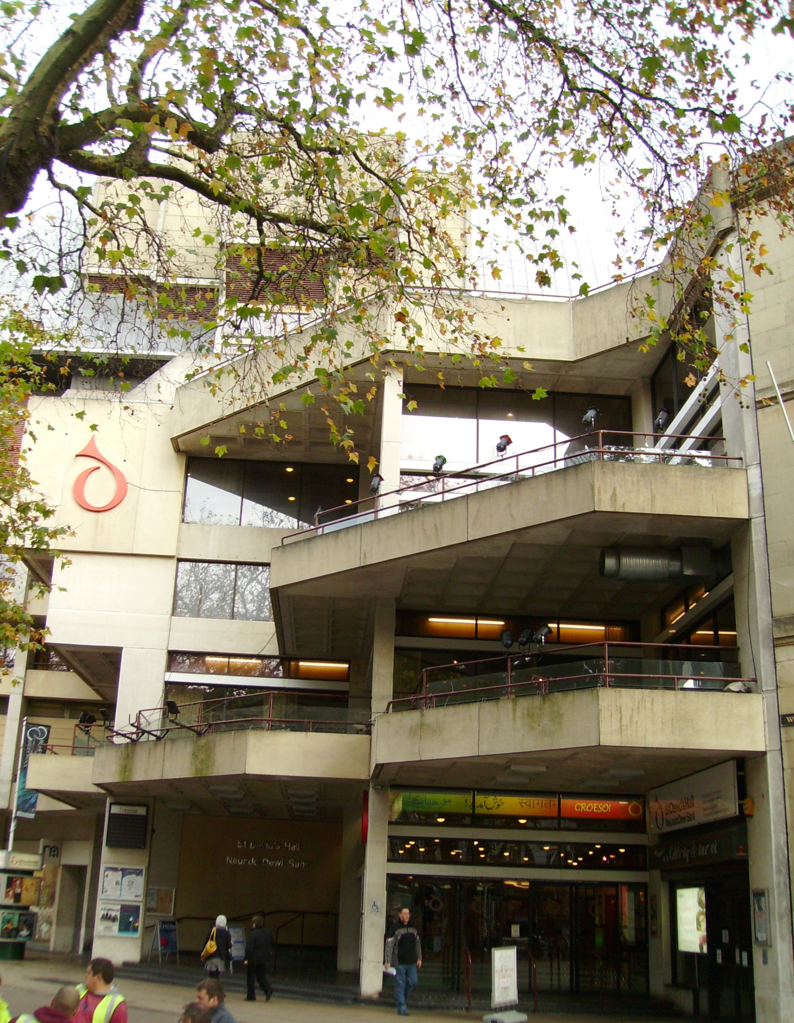
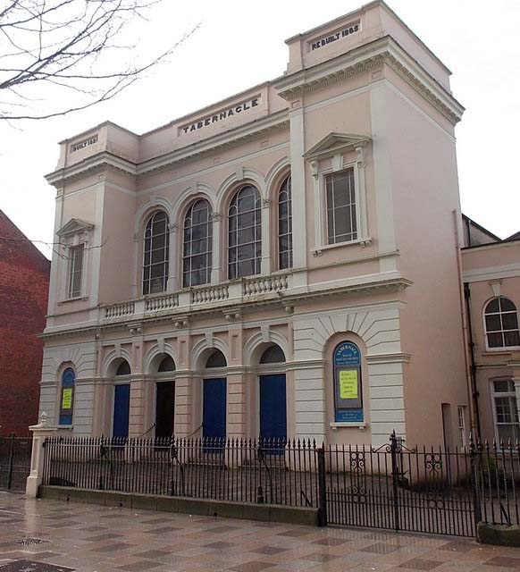
Venues Used
This Photo by Unknown Author is licensed under CC BY-SA

Slide 13

Learn: Shared Learning Projects
Currently: Castles Project

Slide 14


Laugh: Christmas Meal(s)

Slide 15
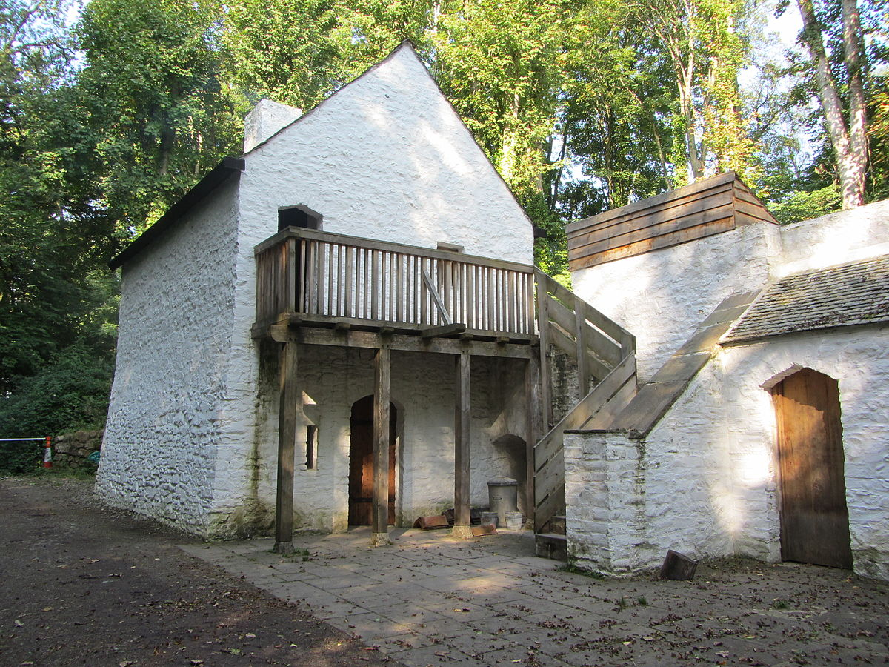
Live: Outside of Cardiff
South Wales Network Events
National Events run by Third Age Trust
Third Age Matters (Trust’s magazine)
Summer Schools

Slide 16
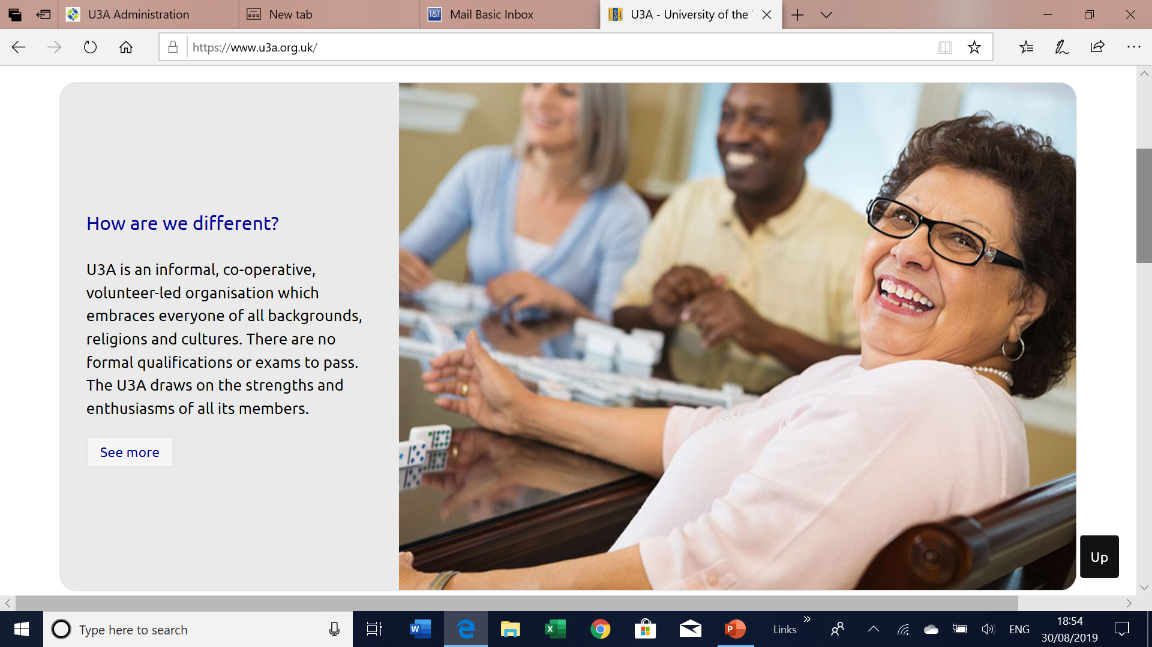
Trust's Strategic Aims are:
Support learning in U3As and promote the benefits of self-help learning.
To provide advice and support for management in U3As.
Facilitate the growth of the U3A movement throughout the United Kingdom.
Raise the Profile of the U3A movement.

Slide 17
Our membership in Cardiff
Number of members
September to August membership year
Join online or by hard copy application form
£12 annual subscription
Session fee at majority of groups (about £1 per hour)
Entirely funded by our own members

Slide 18

Expectations
Members should be prepared to be actively involved
Committee
Groups – run by members
  Historically, paid tutors but no longer the model

Slide 19
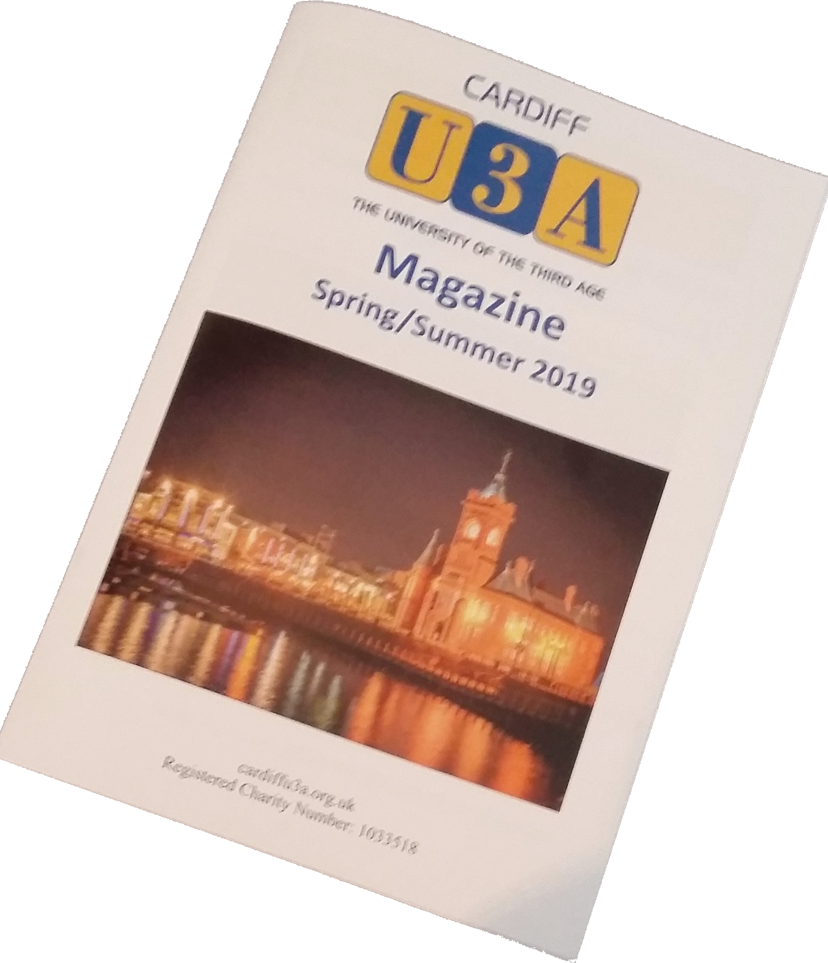
Further Information
Website
  Group pages
  Public calendar
Magazine
Group Activities booklet

Slide 20
Thinking of Joining?
Come along to a Monthly meeting (first visit free)
Attend a Group meeting – check with Convenor first (there may be a fee towards the room hire)
Decide to join
  Go to Cardiff U3A website
  Click on Membership
  Follow instructions for joining
or
  Download an application form or Contact membership secretary

Slide 21

Welcome Coffee Morning

Slide 22

Final points
Cardiff U3A is run for members by members
Each U3A has it’s own groups and membership
We promote education in the age after your working life
We welcome new members and are growing in numbers
Registered Charity Number: 1033518

